Slide 1
Recursion & Dynamic Programming
Hongfei Yan
2021/11/16
Notes:
5.12. Dynamic Programming — Problem Solving with Algorithms and Data Structures (runestone.academy)
https://runestone.academy/runestone/books/published/cppds/Recursion/DynamicProgramming.html
https://runestone.academy/runestone/books/published/pythonds/Recursion/DynamicProgramming.html

Slide 2
计算机思维
Many programs in computer science are written to optimize some value;
for example, find the shortest path between two points,
find the line that best fits a set of points,
or find the smallest set of objects that satisfies some criteria.
There are many strategies that computer scientists use to solve these problems.
Recursion and Dynamic programming are two strategies for these types of optimization problems.

Slide 3
A classic example of an optimization problem involves making change using the fewest coins
Giving out the fewest possible coins in change for each transaction.
Suppose a customer puts in a dollar bill and purchases an item for 37 cents. What is the smallest number of coins you can use to make change?
The answer is six coins: two quarters, one dime, and three pennies.
How did we arrive at the answer of six coins?
start with the largest coin in our arsenal (a quarter) and use as many of those as possible, then we go to the next lowest coin value and use as many of those as possible.
This first approach is called a greedy method because we try to solve as big a piece of the problem as possible right away.
Notes:
arsenal
GRE/TOEFL
英[ˈɑ:sənl]
美[ˈɑrsənl]
释义
n.兵工厂，军火库

Slide 4
Greedy method fails to find the optimal solution
The greedy method works fine when we are using U.S. coins,
but suppose that your company decides to deploy its vending machines in Lower Elbonia where,
in addition to the usual 1, 5, 10, and 25 cent coins they also have a 21 cent coin.
In this instance our greedy method fails to find the optimal solution for 63 cents in change.
With the addition of the 21 cent coin the greedy method would still find the solution to be six coins.
However, the optimal answer is three 21 cent pieces.

Slide 5
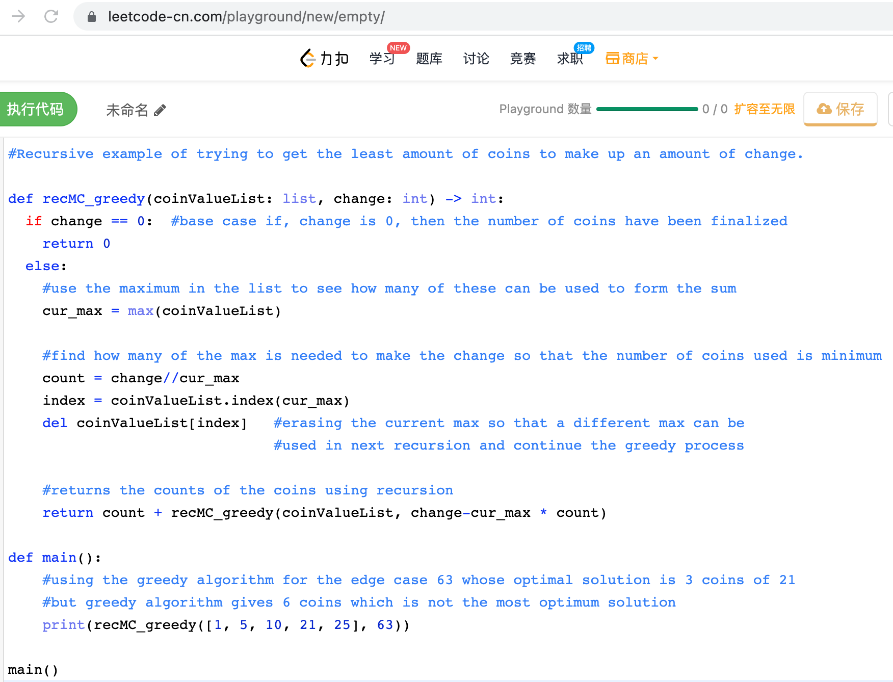
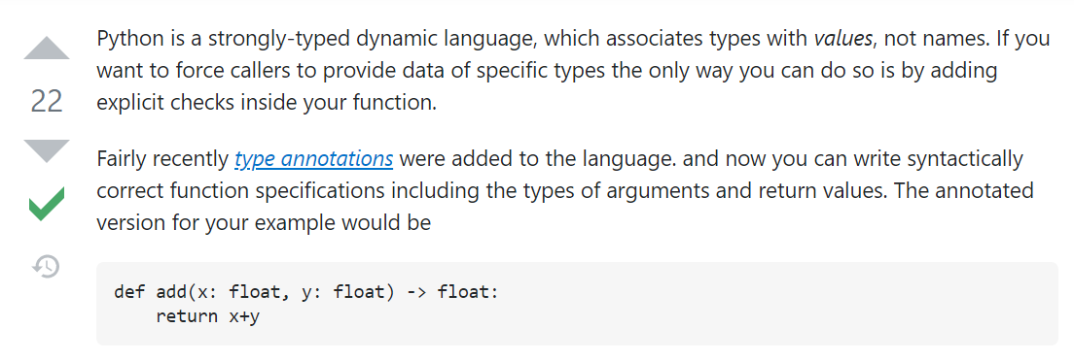
https://stackoverflow.com/questions/43233535/explicitly-define-datatype-in-python-function
Notes:
#Recursive example of trying to get the least amount of coins to make up an amount of change.
def recMC_greedy(coinValueList: list, change: int) -> int:
if change == 0: #base case if, change is 0, then the number of coins have been finalized
return 0
else:
#use the maximum in the list to see how many of these can be used to form the sum
cur_max = max(coinValueList)
#find how many of the max is needed to make the change so that the number of coins used is minimum
count = change//cur_max
index = coinValueList.index(cur_max)
del coinValueList[index] #erasing the current max so that a different max can be
#used in next recursion and continue the greedy process
#returns the counts of the coins using recursion
return count + recMC_greedy(coinValueList, change-cur_max * count)
def main():
#using the greedy algorithm for the edge case 63 whose optimal solution is 3 coins of 21
#but greedy algorithm gives 6 coins which is not the most optimum solution
print(recMC_greedy([1, 5, 10, 21, 25], 63))
main()

Slide 6
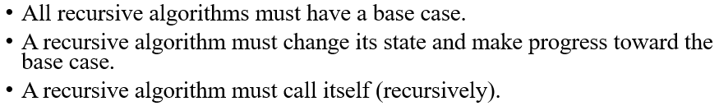
Use a recursive solution
look at a method where we could be sure that we would find the optimal answer to the problem.
we will use a recursive solution.
start with identifying the base case.
If we are trying to make change for the same amount as the value of one of our coins, the answer is easy, one coin.
If the amount does not match we have several options.

Slide 7
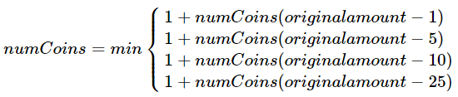
If the amount does not match we have several options.
Want is the minimum of
a penny plus the number of coins needed to make change for the original amount minus a penny,
or a nickel plus the number of coins needed to make change for the original amount minus five cents,
or a dime plus the number of coins needed to make change for the original amount minus ten cents, and so on.
Notes:
the number of coins needed to make change for the original amount can be computed according to the following:

Slide 8
The number of coins needed to make change for the original amount can be computed according to the following:

Slide 9
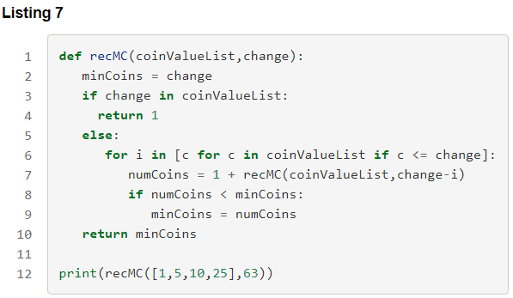
The algorithm for doing what we have just described
Notes:
The algorithm for doing what we have just described is shown in Listing 7. In line 3 we are checking our base case; that is, we are trying to make change in the exact amount of one of our coins. If we do not have a coin equal to the amount of change, we make recursive calls for each different coin value less than the amount of change we are trying to make. Line 6 shows how we filter the list of coins to those less than the current value of change using a list comprehension. The recursive call also reduces the total amount of change we need to make by the value of the coin selected. The recursive call is made in line 7. Notice that on that same line we add 1 to our number of coins to account for the fact that we are using a coin. Just adding 1 is the same as if we had made a recursive call asking where we satisfy the base case condition immediately.

Slide 10
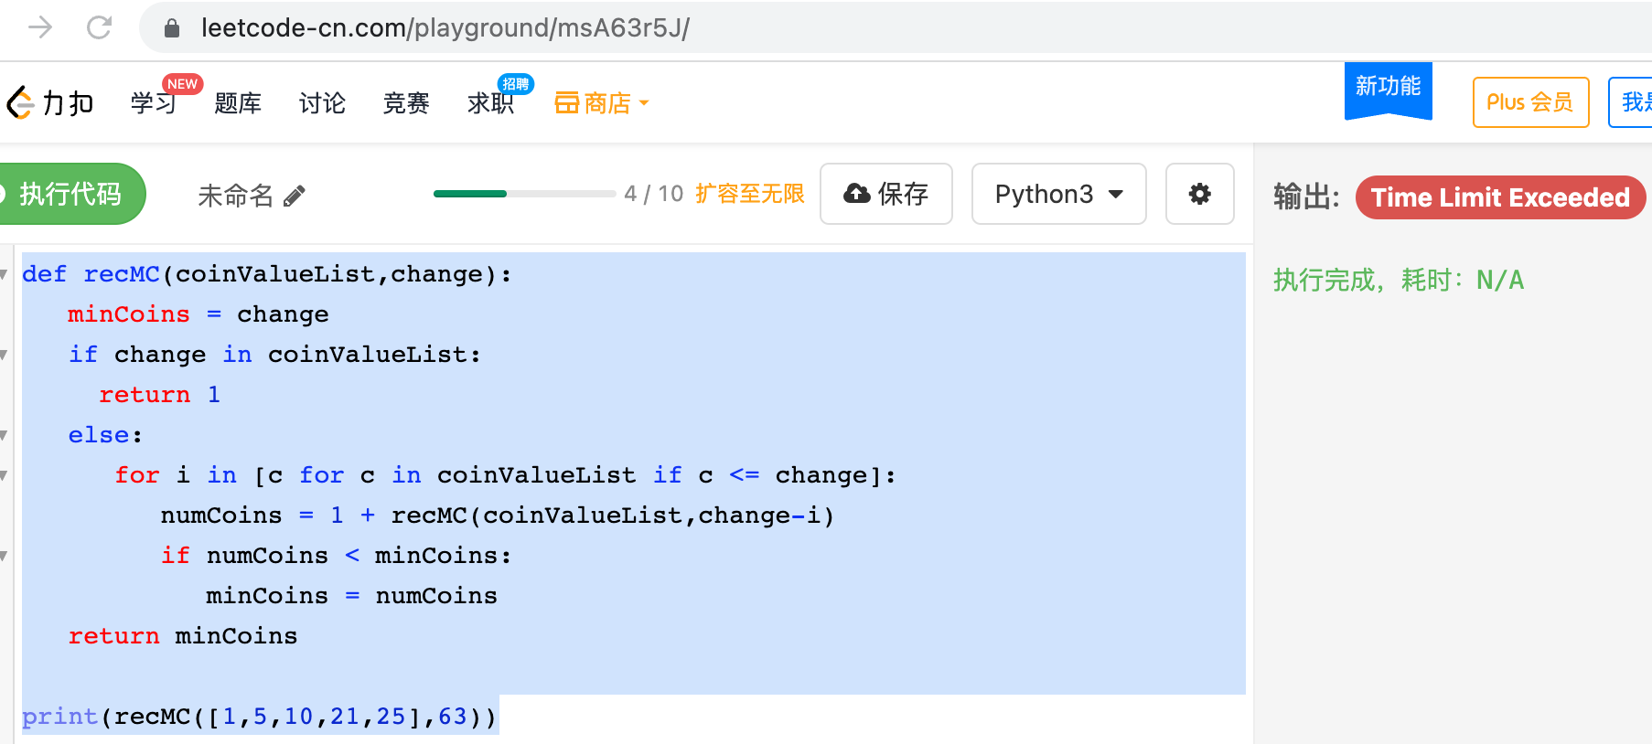
Notes:
def recMC(coinValueList,change):
minCoins = change
if change in coinValueList:
return 1
else:
for i in [c for c in coinValueList if c <= change]:
numCoins = 1 + recMC(coinValueList,change-i)
if numCoins < minCoins:
minCoins = numCoins
return minCoins
print(recMC([1,5,10,21,25],63))

Slide 11
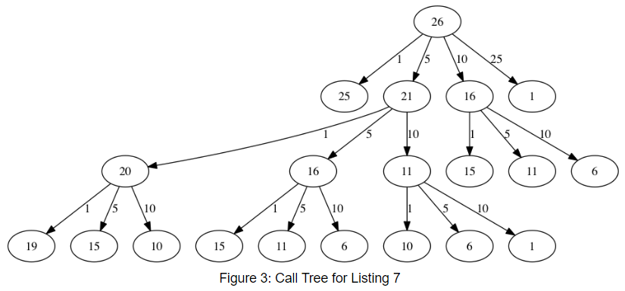
The trouble with the algorithm in Listing 7 is that it is extremely inefficient
It takes 67,716,925 recursive calls to find the optimal solution to the 4 coins, 63 cents problem!
To understand the fatal flaw in our approach look at Figure 3,
which illustrates a small fraction of the 377 function calls needed to find the optimal set of coins to make change for 26 cents.

Slide 12
Illustrates a small fraction of the 377 function calls needed to find the optimal set of coins to make change for 26 cents.
Clearly we are wasting a lot of time and effort recalculating old results.
Notes:
Each node in the graph corresponds to a call to recMC. The label on the node indicates the amount of change for which we are computing the number of coins. The label on the arrow indicates the coin that we just used. By following the graph we can see the combination of coins that got us to any point in the graph. The main problem is that we are re-doing too many calculations. For example, the graph shows that the algorithm would recalculate the optimal number of coins to make change for 15 cents at least three times. Each of these computations to find the optimal number of coins for 15 cents itself takes 52 function calls. Clearly we are wasting a lot of time and effort recalculating old results.

Slide 13
The key to cutting down on the amount of work we do is to remember some of the past results
avoid recomputing results we already know.
A simple solution is to store the results for the minimum number of coins in a table when we find them.
Then before compute a new minimum, first check the table to see if a result is already known.
If there is already a result in the table, use the value from the table rather than recomputing.
The following shows a modified algorithm to incorporate our table lookup scheme.

Slide 14
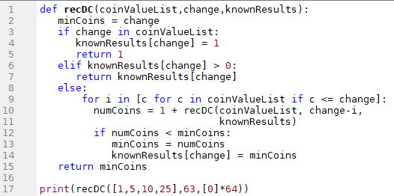
Recursively Counting Coins with Table Lookup
Notes:
Notice that in line 6 we have added a test to see if our table contains the minimum number of coins for a certain amount of change. If it does not, we compute the minimum recursively and store the computed minimum in the table. Using this modified algorithm reduces the number of recursive calls we need to make for the four coin, 63 cent problem to 221 calls!
Although the algorithm in AcitveCode 1 is correct, it looks and feels like a bit of a hack. Also, if we look at the knownResults lists we can see that there are some holes in the table. In fact the term for what we have done is not dynamic programming but rather we have improved the performance of our program by using a technique known as “memoization,” or more commonly called “caching.”

Slide 15
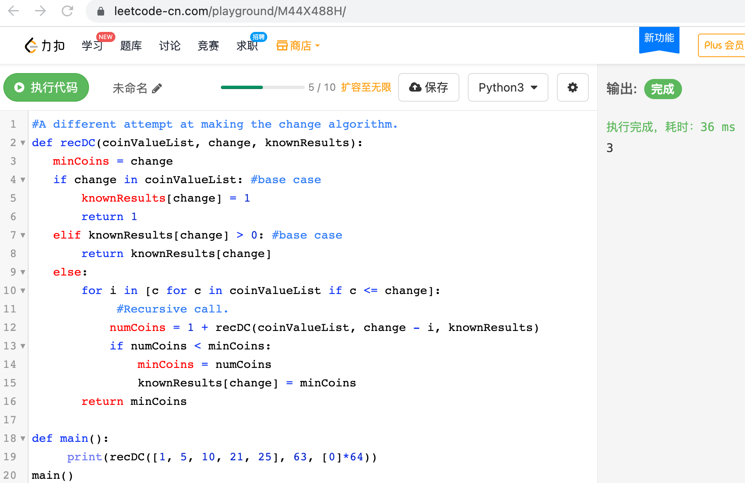
Notes:
#A different attempt at making the change algorithm.
def recDC(coinValueList, change, knownResults):
minCoins = change
if change in coinValueList: #base case
knownResults[change] = 1
return 1
elif knownResults[change] > 0: #base case
return knownResults[change]
else:
for i in [c for c in coinValueList if c <= change]:
#Recursive call.
numCoins = 1 + recDC(coinValueList, change - i, knownResults)
if numCoins < minCoins:
minCoins = numCoins
knownResults[change] = minCoins
return minCoins
def main():
print(recDC([1, 5, 10, 21, 25], 63, [0]*64))
main()

Slide 16
A truly dynamic programming algorithm
A truly DP algorithm will take a more systematic approach to the problem.
DP solution is going to start with
making change for one cent and
systematically work its way up to the amount of change we require.
This guarantees us that at each step of the algorithm
already know the minimum number of coins needed to make change for any smaller amount.

Slide 17
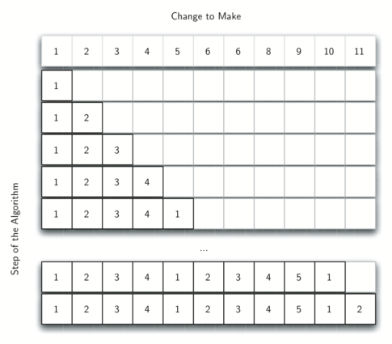
Figure 4: Minimum Number of Coins Needed to Make Change
Notes:
Let’s look at how we would fill in a table of minimum coins to use in making change for 11 cents. Figure 4 illustrates the process. We start with one cent. The only solution possible is one coin (a penny). The next row shows the minimum for one cent and two cents. Again, the only solution is two pennies. The fifth row is where things get interesting. Now we have two options to consider, five pennies or one nickel. How do we decide which is best? We consult the table and see that the number of coins needed to make change for four cents is four, plus one more penny to make five, equals five coins. Or we can look at zero cents plus one more nickel to make five cents equals 1 coin. Since the minimum of one and five is one we store 1 in the table. Fast forward again to the end of the table and consider 11 cents.

Slide 18
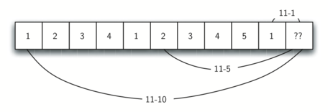
Figure 5: Three Options to Consider for the Minimum Number of Coins for Eleven Cents
Either option 1 or 3 will give us a total of two coins which is the minimum number of coins for 11 cents.
Notes:
Figure 5 shows the three options that we have to consider:
A penny plus the minimum number of coins to make change for 11−1=10 cents (1)
A nickel plus the minimum number of coins to make change for 11−5=6 cents (2)
A dime plus the minimum number of coins to make change for 11−10=1 cent (1)
Either option 1 or 3 will give us a total of two coins which is the minimum number of coins for 11 cents.

Slide 19
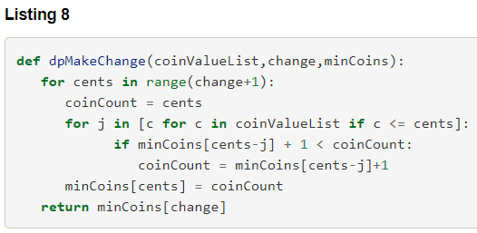
A DP algorithm to solve our change-making problem
Notes:
dpMakeChange takes three parameters:
a list of valid coin values,
the amount of change we want to make,
and a list of the minimum number of coins needed to make each value.
When the function is done minCoins will contain the solution for all values from 0 to the value of change.
----------
Note that dpMakeChange is not a recursive function, even though we started with a recursive solution to this problem.
It is important to realize that just because you can write a recursive solution to a problem does not mean it is the best or most efficient solution.
The bulk of the work in this function is done by the loop that starts on line 4.
In this loop we consider using all possible coins to make change for the amount specified by cents.
Like we did for the 11 cent example above, we remember the minimum value and store it in our minCoins list.

Slide 20
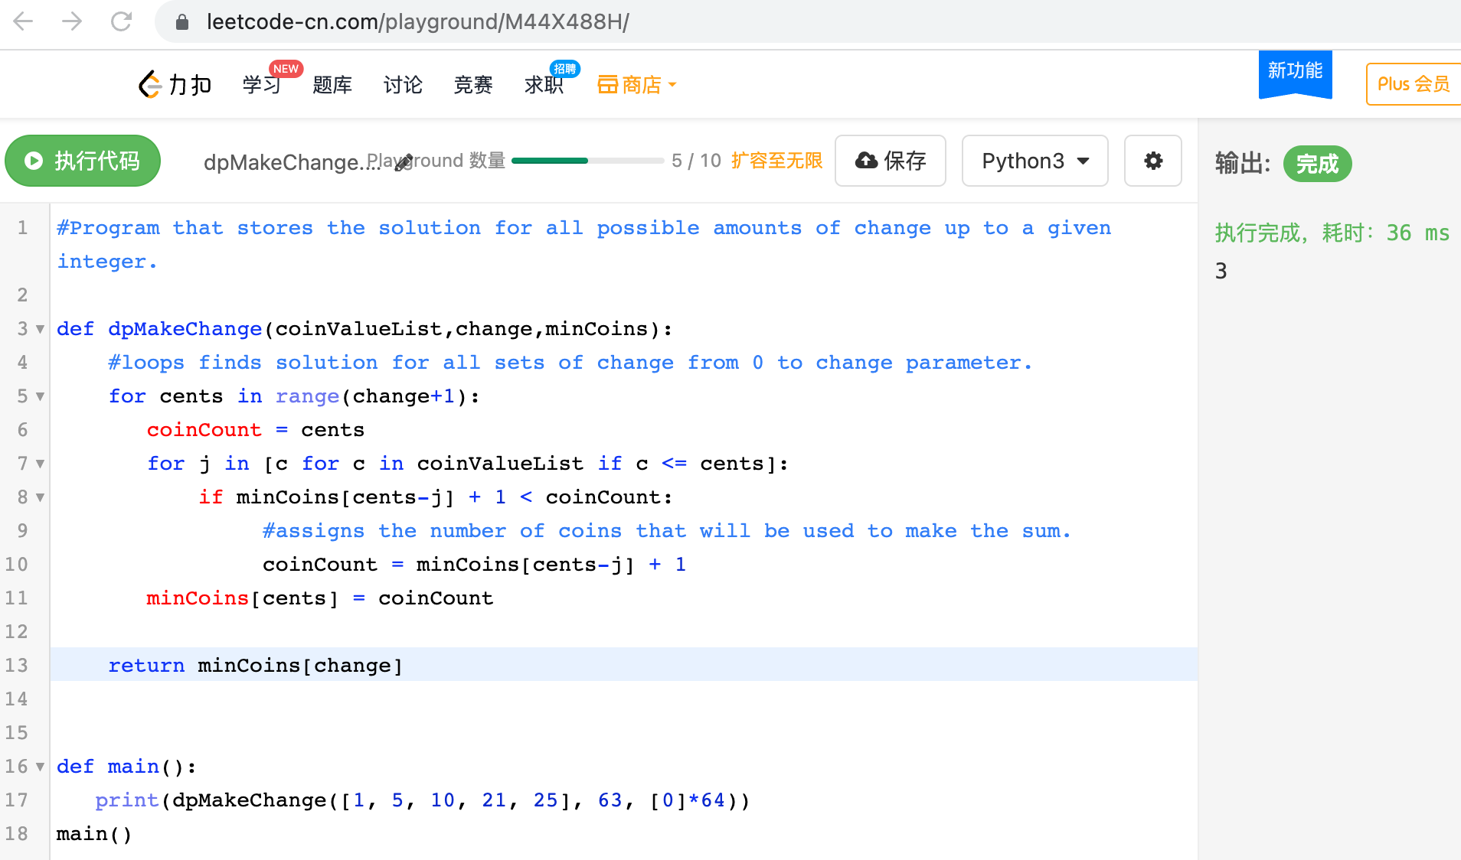
Notes:
#Program that stores the solution for all possible amounts of change up to a given integer.
def dpMakeChange(coinValueList,change,minCoins):
#loops finds solution for all sets of change from 0 to change parameter.
for cents in range(change+1):
coinCount = cents
for j in [c for c in coinValueList if c <= cents]:
if minCoins[cents-j] + 1 < coinCount:
#assigns the number of coins that will be used to make the sum.
coinCount = minCoins[cents-j] + 1
minCoins[cents] = coinCount
return minCoins[change]
def main():
print(dpMakeChange([1, 5, 10, 21, 25], 63, [0]*64))
main()

Slide 21
Although our making change algorithm does a good job of figuring out the minimum number of coins,
it does not help us make change since do not keep track of the coins used.
Easily extend dpMakeChange to keep track of the coins used
by simply remembering the last coin we add for each entry in the minCoins table.
Know the last coin added, simply subtract the value of the coin to find a previous entry in the table
that tells us the last coin we added to make that amount.
keep tracing back through the table until get to the beginning.

Slide 22
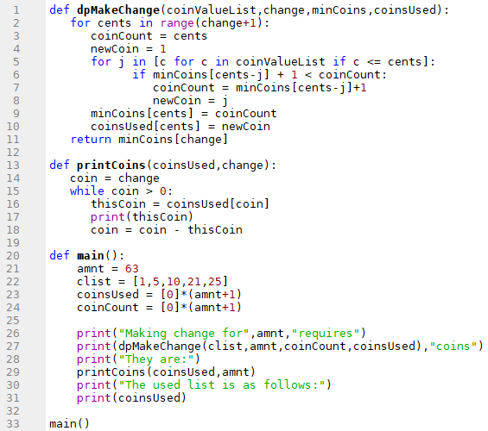
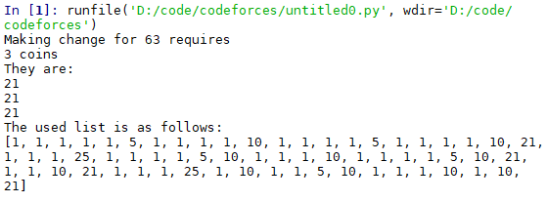
Complete Solution to the Change Problem
Notes:
ActiveCode 2 shows the dpMakeChange algorithm modified to keep track of the coins used, along with a function printCoins that walks backward through the table to print out the value of each coin used. This shows the algorithm in action solving the problem for our friends in Lower Elbonia. The first two lines of main set the amount to be converted and create the list of coins used. The next two lines create the lists we need to store the results. coinsUsed is a list of the coins used to make change, and coinCount is the minimum number of coins used to make change for the amount corresponding to the position in the list.
Notice that the coins we print out come directly from the coinsUsed array. For the first call we start at array position 63 and print 21. Then we take 63−21=42 and look at the 42nd element of the list. Once again we find a 21 stored there. Finally, element 21 of the array also contains 21, giving us the three 21 cent pieces.
5.12. Dynamic Programming — Problem Solving with Algorithms and Data Structures (runestone.academy)

Slide 23
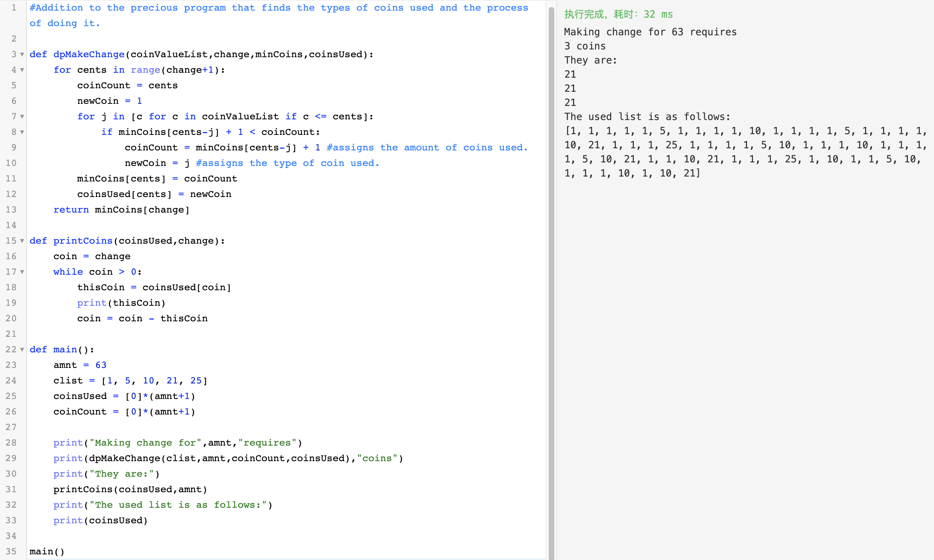

Slide 24
Summary
Recursion is an effective problem-solving technique. The key points to remember are as follows:
All recursive algorithms must have a base case.
A recursive algorithm must change its state and make progress toward the base case.
A recursive algorithm must call itself (recursively).
Recursion can take the place of iteration in some cases.
Recursive algorithms often map very naturally to a formal expression of the problem you are trying to solve.
Recursion is not always the answer.
Sometimes a recursive solution may be more computationally expensive than an dynamic programming algorithm.

